Slide 1
SWE 4701
Software Metrics and Process
Lec - 6

Slide 2
Measuring external product attributes: quality

Slide 3
Quality
Meaning of SW Quality:
  Fitness for purpose
  Conformance to specification
  Degree of excellence
  Timeliness
However, we must be able to define quality in terms of specific software product attributes
We will figure out the quality attributes in measurable form..

Slide 4
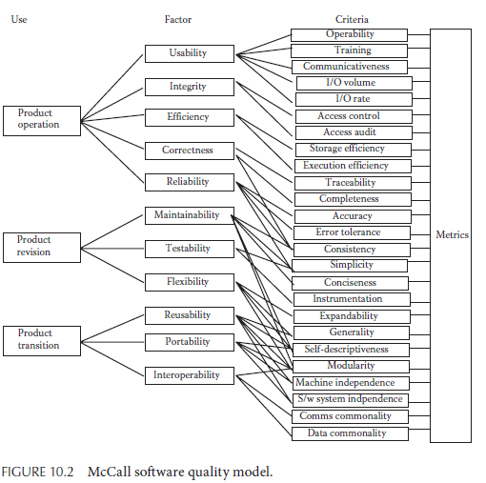
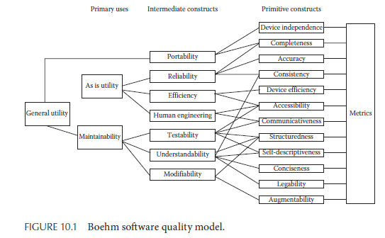
SOFTWARE QUALITY MODELS

Slide 5
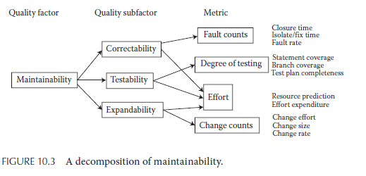
Decomposition of Attributes

Slide 6
Approaches to Monitoring Software Quality
Software quality must be monitored to ensure that a product meets required standards.
Quality models help in evaluating and controlling different attributes of software.
There are two common approaches used to monitor software quality.
  Fixed Model Approach
  Define Your Own Quality Model Approach

Slide 7
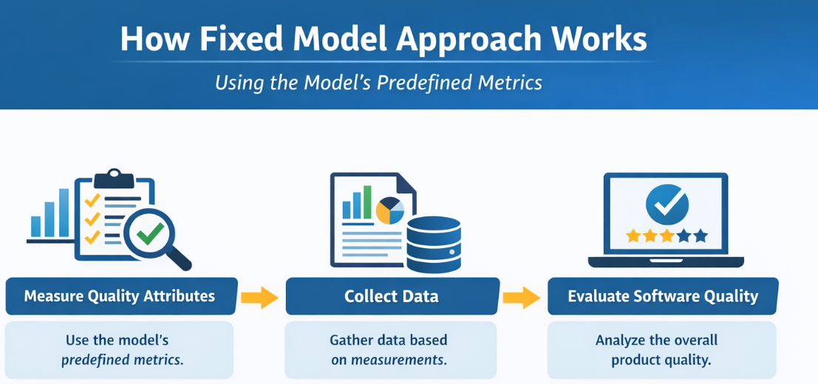
Fixed Model Approach
In this approach, an existing published quality model is used.
All important quality factors are assumed to be included in that model.
The predefined criteria and metrics of the model are accepted.
Relationships among factors, criteria, and metrics are also adopted.

Slide 8
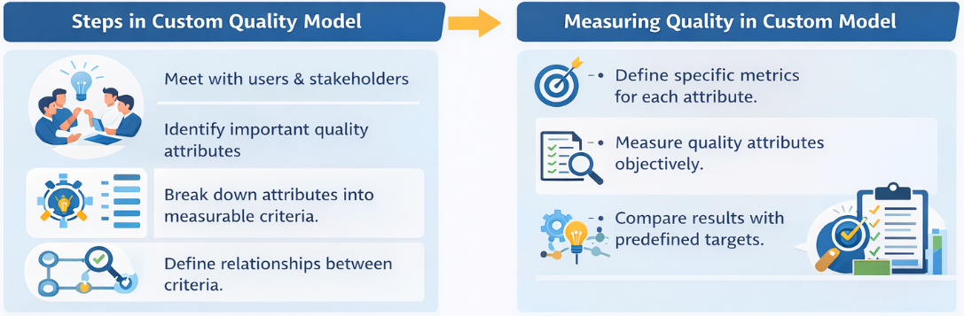
Defining Custom Quality Model
This approach does not fully rely on a predefined quality model.
Instead, the development team and users decide which quality attributes are important.
The model is customized based on the specific needs of the product.

Slide 9
ISO/IEC 25010 Software Quality Model
In 2011, ISO/IEC 25010 replaced the earlier ISO/IEC 9126-1 standard.
It is part of the SQuaRE (Systems and Software Quality Requirements and Evaluation) framework.
The model defines the key characteristics used to evaluate software product quality.
ISO/IEC 25010 divides software quality into eight main characteristics:
  Functional Suitability
  Performance Efficiency
  Compatibility
  Usability
  Reliability
  Security
  Maintainability
  Portability

Slide 10
ISO/IEC 25010 Software Quality Model
The standard states that these eight characteristics are comprehensive.
This means:
    Any aspect of software quality can be described using one or more of these characteristics.
    Together they provide a complete framework for evaluating software quality.
Each of the eight characteristics can be further divided into smaller attributes called sub-characteristics.
These sub-characteristics:
  Focus on specific aspects of software behavior
  Help measure quality more precisely
  Can be refined into multiple levels of detailed evaluation

Slide 11
Measuring Aspects of Quality
Many software engineers assess quality using specific measures designed for particular purposes, rather than formal quality models.
These measures often reflect:
  The intended use of the software
  Testing realities
  System requirements
Example attributes:
  Portability – the ability to move software to another environment
  Integrity – ensuring only authorized users can modify the system

Slide 12
Measuring Aspects of Quality
Example:
Portability can be defined as:
Portability = 1 − (ET / ER)
Where: ET = Resources needed to move the system to the target environment
ER = Resources needed to build the system in the resident environment
Suppose:
It took 100 hours to build the system originally
So ER = 100
And it takes 20 hours to move it to a new environment
So ET = 20
We can measure, Portability = 1 − (20 / 100) = 1 − 0.2 = 0.8
The software is quite portable because moving it takes much less effort than building it from scratch.

Slide 13



Defect-Based Quality Measures
In many situations, quality is viewed simply as the absence of defects.
A defect can mean:
  An error
  A fault
  A failure in the system
Error
Fault/Defect/Bug
Whenever a development team member makes a mistake in any phase of SDLC, errors are produced. It might be a typographical error, and so on.
is an error in code due to incorrect design, logic, or implementation where the software does not behave as expected.
Defects are categorized into:
• Known defects – discovered during testing or inspection
• Latent defects – present but not yet discovered
Failure
Is the inability of a system or component to perform a required function according to its specification.

Slide 14
Defect Density
A widely used measure of software quality is defect density.
Lower defect density generally indicates better software quality.
Defect Density = Number of Known Defects / Product Size
Product size is usually measured in:
  Lines of Code (LOC)
  Function Points
Defect density has several limitations
  No universal definition of a defect
  Defect counts may refer to different life-cycle stages
  Software size measurement methods vary
  Results may reflect the defect detection process rather than actual product quality
  Not all faults lead to failures in real use
Studies show that:
• A small number of faults cause most failures
• Many faults may never cause failures
Therefore: A system may contain many faults but still operate reliably in practice.

Slide 15

Defect Removal Efficiency (DRE)
it measures how effective your development and testing process is at catching defects before the software is released.
Think of it as a “quality checkpoint” metric.
$\text{DRE}=\frac{E}{E+D}$ × 100%
E is the number of defects found before delivery to the end user
D is the number of defects found after delivery.
So, if your team catches almost everything during development, DRE is high.
For example, you found 10 defects after you delivered your product. There were 990 defects found and removed before delivery. Your DRE =990/1000 = 99%.
Why it matters for quality:
High DRE → High Quality:
  If most defects are removed before release, the software is more reliable, stable, and user-friendly.
  Fewer post-release issues → better reputation, less maintenance cost, happier users.
Low DRE → Poor Quality:
  Many defects escape to production, meaning users will encounter bugs.
  This reflects problems in testing, design, or coding practices.

Slide 16

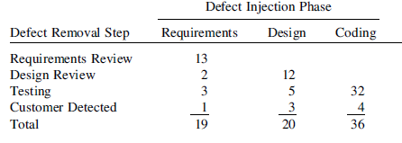
DRE per Activity
DREᵢ = Eᵢ / (Eᵢ + Eᵢ₊₁)
Eᵢ = Number of defects found in activity i
Eᵢ₊₁ = Number of errors found later that originated from defects in activity i
For example, You have four defect removal steps: (1) requirements review, (2) design review, (3) testing, and
(4) customer detected. You have three phases of defect insertion that you track: (1) requirements, (2) design, and (3) coding.
Can you measure the DRE for each phase?
What will be the DRE for this system?
DRE (System) =67/75
DRE (Requirements)
Total requirements defects = 19
Caught in Requirements Review = 13
DRE = 13 / 19 ≈ 0.68
DRE (Design)
Defects possible in Design = defects originating from Requirements + Design = 6 (requirements left after Requirements Review) + 20 (design defects) = 26
Defects caught in Design Review = 14
DRE (Testing) = 40/48
DRE (Customer Detected) = 8/8
DRE(design​)=14/26​≈0.54

Slide 17
Other Defect-Based Measures
Organizations also track additional defect-based metrics such as:
  Cumulative fault density—faults found internally
  Cumulative fault density—faults found by customers
  Total serious faults found
  Mean time to close serious faults
  Total field fixes
  High-level design review errors per thousand NCLOC
  Low-level design errors per thousand NCLOC
  Code inspection errors per inspected thousand NCLOC
  Development test and integration errors found per thousand NCLOC
  System test problems found per developed thousand NCLOC
  First application test site errors found per developed thousand NCLOC
  Customer found problems per developed thousand NCLOC

Slide 18
You are building a commercial application. Your CEO, who is very dedicated to quality, directs you to find and fix 99% of the bugs before you ship. What should be your response?

Slide 19
Usability Measures

Slide 20
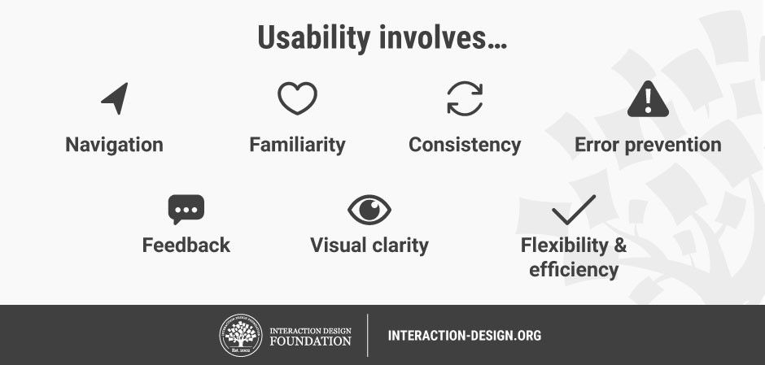
What is usability?
Usability is a measure of the effectiveness, efficiency and satisfaction with which specified users can achieve specified goals in a particular environment.
Usability is considered an external quality attribute.

Slide 21
Why is usability important?
Poor usability results in
  anger and frustration
  decreased productivity in the workplace
  higher error rates
  physical and emotional injury
  equipment damage
  loss of customer loyalty
  costs money

Slide 22





Key Usability Factors
Efficiency of Use
Error Frequency
Once users have learned the system, how fast can they complete tasks?
How often do users make mistakes, and how severe are they?
Ease of Learning
Memorability
User Satisfaction
How quickly can new users understand and start using the product effectively?
When users return to the design after a period of not using it, how easily can they re-establish proficiency?
How pleasant, enjoyable, and frustration-free is the overall experience?
A form that auto-detects invalid email formats and highlights the field in red (with a helpful message) prevents submission errors
Keyboard shortcuts in a photo editing app (like Ctrl+Z for undo) allow experienced designers to edit images much faster
The first time you open the app, it tells you to "Swipe Right" to like and "Swipe Left" to pass. It takes less than 3 seconds to learn the entire application.
A clean, beautiful e-commerce checkout with progress indicators and reassuring messages ("You're almost done!") makes users feel confident and happy rather than stressed.
Consistent icons across apps (trash can = delete, magnifying glass = search) mean users remember where things are even if they only use the app once a month.

Slide 23
Usability Measurement Areas
Usability Measurement Areas
Effectiveness
Satisfaction
Effectiveness measures how well users complete tasks.
Examples:
• Percentage of tasks completed
• Number of errors made
Reflects users’ perceptions and experiences.
Measured through:
• Questionnaires
• User surveys
• Preference rankings
• Behavioral observations
Efficiency
Time and effort required to perform tasks
Examples:
• Task completion time
• Input speed (keyboard, mouse)

Slide 24
Internal Attributes Affecting Usability
Some internal design elements believed to improve usability include:
  Clear menus and graphics
  Informative error messages
  Help system
  Consistent interfaces
  Well-structured manuals
However, these are indirect indicators, not direct usability measures.

Slide 25
Maintainability measures
Maintainability refers to how easily software can be modified or updated.
It is not limited to source code. It also applies to:
  Software specifications
  Design documents
  Test plans
Maintainability depends on:
  The software product
  The developer performing maintenance
  Available documentation and tools
  The way the software is used

Slide 26
Maintainability measures
Two Approaches to Measuring Maintainability:
  External Approach
    Measure the maintenance process itself.
    If changes can be implemented quickly and efficiently, the software is considered maintainable.
  2. Internal Approach
    Analyze internal characteristics of the software, such as structure or complexity, to predict maintainability.
    Internal measures help predict maintainability but cannot define it completely.

Slide 27




Maintainability measures
Types of Software Maintenance
Corrective maintenance
Adaptive maintenance
Perfective maintenance
Preventative maintenance
This includes modifications and updations done in order to correct or fix problems, which are either discovered by user or concluded by user error reports.
This includes modifications and updations applied to keep the software product up-to date and tuned to the ever changing world of technology and business environment.
This includes modifications and updates done in order to keep the software usable over long period of time. It includes new features, new user requirements for refining the software and improve its reliability and performance.
This includes modifications and updations to prevent future problems of the software. It aims to attend problems, which are not significant at this moment but may cause serious issues in future.

Slide 28
Maintainability measures
Mean Time to Repair (MTTR)
  A common maintainability metric is Mean Time to Repair (MTTR).
  Average time required to fix a problem and restore the system.
  MTTR indicates how quickly maintenance can be performed.
Example:
  In large web systems, reducing MTTR improves system availability more effectively than reducing failure rates.
To measure MTTR accurately, several time components must be recorded:
  Problem recognition time
  Administrative delay time
  Tool preparation time
  Problem analysis time
  Change specification time
  Change implementation and testing time

Slide 29
Maintainability measures
There are many indicators of maintainability other than MTTR
  Average time needed to implement changes
  Number of unresolved issues
  Time spent fixing unresolved problems
  Percentage of changes that introduce new errors
  Number of modules affected by a change
Certain internal characteristics of software may influence maintainability:
  Code complexity
  Module size
  Code structure
  Documentation quality

Slide 30
Security measures
Software security ensures that systems protect data and prevent unauthorized access.
Security is the ability of a system to protect information and allow access only to authorized users.
Security is considered an external attribute, as attackers interact with the system from outside.
Security risks depend on four factors:
  Impact – damage caused by an attack
  Likelihood – probability of an attack
  Threat – source of the attack
  Vulnerability – weakness in the system

Slide 31
Security measures
Common Vulnerability Scoring System (CVSS)
The CVSS is a widely used system to measure software vulnerabilities.
Scores range from 0 to 1:
    0 → No vulnerability
    1 → Maximum vulnerability
CVSS evaluates several aspects of a vulnerability.
Key CVSS metrics include:
• Access Vector (AV) – how attackers reach the system
• Access Complexity (AC) – difficulty of performing the attack
• Authentication (Au) – number of login steps required
• Confidentiality Impact (C) – risk of data exposure
• Integrity Impact (I) – risk of data modification
• Availability Impact (A) – risk of system shutdown
CVSS is not a measure of risk. It is a method used to supply a qualitative measure of severity.

Slide 32
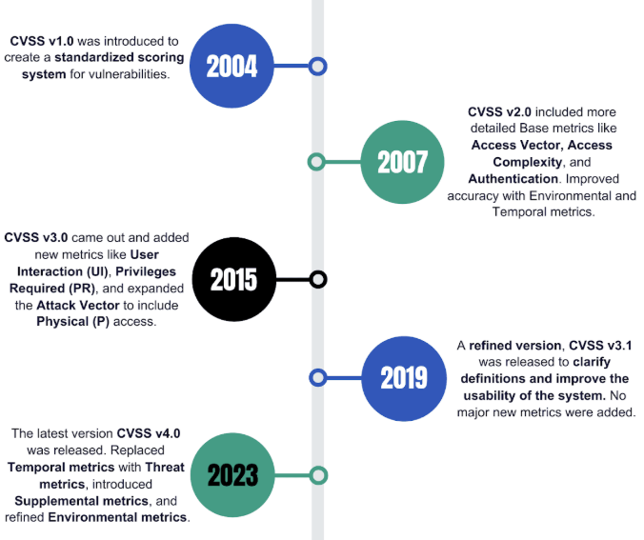
Security measures
CVSS History

Slide 33
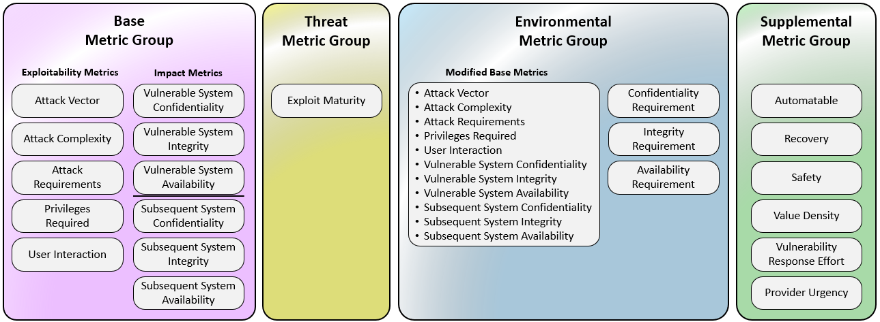
Security measures
CVSS Metric Groups

Slide 34
Security measures
CVSS Qualitative Severity Ratings
CVSS v2.0 Ratings |  | CVSS v3.x Ratings |  | CVSS v4.0 Ratings
Severity | Severity Score Range | Severity | Severity Score Range | Severity | Severity Score Range
 |  | None* | 0.0 | None* | 0.0
Low | 0.0-3.9 | Low | 0.1-3.9 | Low | 0.1-3.9
Medium | 4.0-6.9 | Medium | 4.0-6.9 | Medium | 4.0-6.9
High | 7.0-10.0 | High | 7.0-8.9 | High | 7.0-8.9
 |  | Critical | 9.0-10.0 | Critical | 9.0-10.0

Slide 35
Security measures
CVSS Base Score Calculation
Step 1: Impact Calculation
Impact measures the damage caused if the vulnerability is successfully exploited.
Formula: Impact = 10.41 × (1 − (1 − C) × (1 − I) × (1 − A))
Where: C = Confidentiality Impact, I = Integrity Impact, A = Availability Impact
Step 2: Exploitability Calculation
Exploitability measures how easy it is for an attacker to exploit the vulnerability.
Formula: Exploitability = 20 × AV × AC × Au
Where: AV = Access Vector, AC = Access Complexity, Au = Authentication
Higher exploitability means the attack is easier to perform.
Step 3: CVSS Base Score Calculation
The final CVSS score combines Impact and Exploitability.
Formula: Base Score = (0.6 × Impact + 0.4 × Exploitability − 1.5) × 1.176
This produces the final vulnerability score.

Slide 36
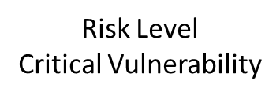
Example
A vulnerability has been discovered in an online banking web application, and security analysts evaluated it using the Common Vulnerability Scoring System (CVSS) base metrics. The vulnerability can be exploited remotely through the internet without requiring physical access to the system; therefore, the Access Vector (AV) is considered Network with a value of 1.0. The attack is relatively easy to perform and does not require complex conditions, so the Access Complexity (AC) is categorized as Low with a value of 0.71. In addition, the attacker does not need to authenticate or log in before launching the attack, which means the Authentication (Au) level is None with a value of 0.704. If the attack is successful, sensitive customer information could be exposed, indicating a Complete impact on confidentiality(C) with a value of 0.660. Furthermore, the attacker may modify important financial records, resulting in a Complete integrity impact(I) with a value of 0.660. The attack could also disrupt the banking service by causing the system to crash or become unavailable to users, leading to a Complete availability impact(A) with a value of 0.660. find CVSS Base Score
Step 1: Calculate Impact
Impact formula: Impact = 10.41 × (1 − (1 − C)(1 − I)(1 − A))
= 10.41 × (1 − (1 − 0.660)(1 − 0.660)(1 − 0.660)) ≈ 10.0
Step 2: Calculate Exploitability
Exploitability formula: Exploitability = 20 × AV × AC × Au
= 20 × 1.0 × 0.71 × 0.704 ≈ 9.99
Step 3: Calculate Base Score
Base Score formula: Base Score = (0.6 × Impact + 0.4 × Exploitability − 1.5) × 1.176
= (0.6 × 10 + 0.4 × 9.99 − 1.5) × 1.176 ≈ 10

